Slide 1
Unique Binary Search Tree
By
G.Nagarjuna – (192211487)

Slide 2
PROBLEM STATEMENT
Binary Search Trees (BSTs) are a fundamental data structure in computer science and have a wide range of applications, from efficient data storage to quick search operations. A BST is a binary tree in which each node has a unique value, and the tree satisfies the following properties:
The left subtree of a node contains only nodes with values less than the node's value.
The right subtree of a node contains only nodes with values greater than the node's value.
Given an integer n, we are interested in finding the number of structurally unique BSTs that can be formed using nodes with unique values from 1 to n.

Slide 3
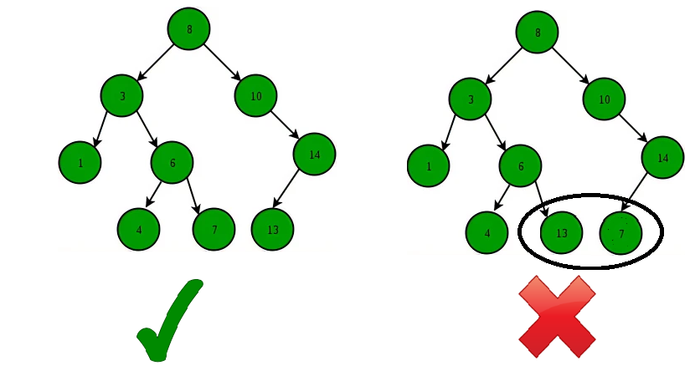
ABSTRACT
A binary search tree is a data structure that allows efficient searching, insertion, and deletion operations. It is commonly used in various applications, including databases, search engines, and operating systems.
A unique binary search tree is a specific type of binary search tree that has the property of having no duplicate nodes. This uniqueness constraint adds complexity to certain operations, but it can also provide performance benefits in certain scenarios.

Slide 4
INTRODUCTION
Structurally unique BSTs are those that differ in their structure, not just in node values. For example, even if two trees have the same values, they are considered different if their arrangement or shape is different.
Understanding the number of unique BSTs is crucial for several reasons:
Algorithm Design: Helps in the design of algorithms that need to consider different possible structures, such as dynamic programming solutions.
Database Indexing: BSTs are often used in databases for indexing. Knowing the number of unique structures helps in optimizing query performance.
Combinatorial Problems: This problem is a classic example of combinatorial counting, which has applications in various fields including mathematics, computer science, and engineering.

Slide 5

Catalan Numbers
The problem of counting the number of structurally unique BSTs for n nodes can be solved using Catalan numbers, a sequence of natural numbers with applications in various combinatorial mathematics problems. The n-th Catalan number Cn gives the number of distinct BSTs that can be formed with n nodes.
Formula for Catalan Numbers

Slide 6
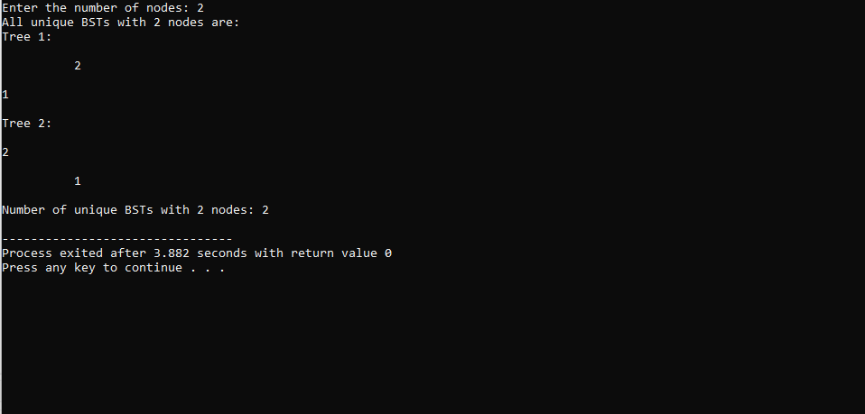
OUTPUT

Slide 7
Applications of Unique Binary Search Trees
Data Structures: Unique BSTs are used to build balanced and efficient search trees.
Parsing Algorithms: They are used in parsing algorithms for languages and in the construction of syntax trees.
Combinatorial Enumeration: Counting unique BSTs is a fundamental problem in combinatorial enumeration, with applications in various fields of science and engineering.

Slide 8
Time Complexity of Operations on Unique Binary Search Trees
Operation
Time Complexity
Search
O(h)
Insertion
O(h)
Deletion
O(h)
Min/Max
O(h)
Predecessor/Successor
O(h)

Slide 9
The time complexity of these operations depends on the height (h) of the binary search tree. In the best case, where the tree is balanced, the height is logarithmic to the number of nodes (n), resulting in O(log n) time complexity. However, in the worst case, where the tree is skewed, the height can be linear to the number of nodes, leading to O(n) time complexity.

Slide 10
Conclusion and Future Directions
In conclusion, Unique Binary Search Trees are a fundamental data structure with numerous applications in computer science. Their efficiency and versatility make them a valuable tool for organizing and searching data.
Future research could explore the development of novel algorithms for generating and manipulating Unique Binary Search Trees, optimizing their performance in specific contexts. Additionally, the integration of Unique Binary Search Trees with other data structures and algorithms could lead to advancements in areas such as artificial intelligence and machine learning.

Slide 11


